Slide 1
Game’s pipeline integration with Babylon.js
Introduction to WebGL 3D with HTML5 and Babylon.js

Slide 2


WHO ARE WE?
Geeks, web developers, 3D addicts
DAVID ROUSSET
DAVID CATUHE
TECHNICAL EVANGELIST
PRINCIPAL PROGRAM MANAGER
Twitter: @davrous
http://blogs.msdn.com/davrous
Twitter: @deltakosh
http://blogs.msdn.com/eternalcoding
Do not try to tune your speakers, the weird sound is due to French accent…

Slide 3
AGENDA
1
Working with Blender 3D
2
Working with 3ds Max
3

Slide 4
Section One
Working with Blender 3D
And the Sandbox

Slide 5







Creation Pipeline
.babylon
.FBX
converter
.OBJ
.FBX
.OBJ

Slide 6
Blender to Babylon.js exporter features support
Cameras
Name
Position
Target
Fov
Clip start
Clip end
Check collisions
Gravity
Ellipsoid
Lights
Type (Point, directional (Sun), Spot, Hemispheric)
Name
Position
Direction
Spot size
Spot blend
Energy
Diffuse color
Specular color
Materials & Multi-mat
Name
Ambient color
Diffuse color
Specular color
Specular hardness
Emissive color
Alpha
Backface culling
Diffuse texture
Ambient texture
Opacity texture
Reflection texture
Emissive texture
Bump texture
Textures
Name
Associated file
Level
Use alpha
uOffset / voffset
uScale / uScale
uAng / vAng / Wang
WrapU / WrapV
Coordinates index
Meshes
Name
Geometry (Positions & normals)
Position
Rotation
Scaling
Texture coordinates (2 channels)
Vertex colors
Visibility
Check collisions
Billboard
Receive and cast shadows
Bones (armatures) and bones' animations
◦Animations

Slide 7
USING BLENDER EXPORTER & THE SANDBOX
DEMO

Slide 8
Section Two
Working with 3ds Max

Slide 9
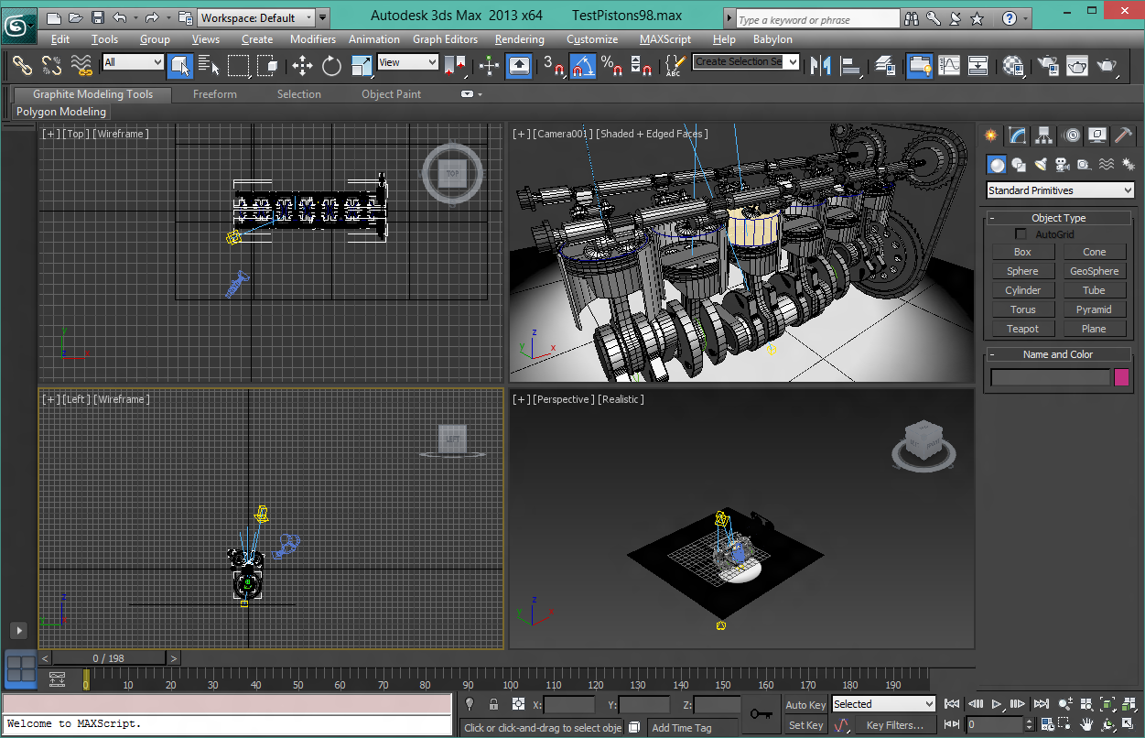
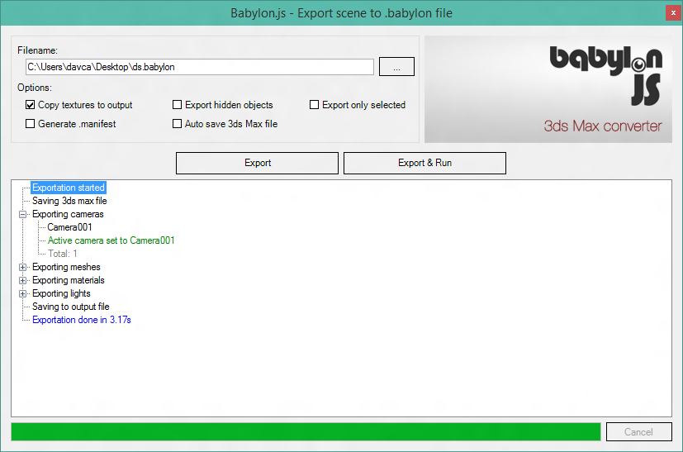
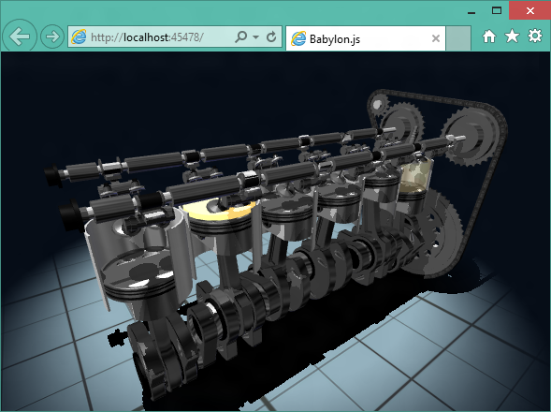
Fully integrated pipeline exportation
One click exportation
Integrated web server
Export:
Cameras, lights, meshes
Animations and regular materials

Slide 10
USING 3DS MAX EXPORTER
DEMO

